Slide 1
Parish Coastal Mission
To build and manage a resilient and sustainable coastal community by stewarding restoration projects with state and federal agencies;
Coastal Use Permit management of construction, development, and production activities in our coastal zone
Educate our parish on coastal issues through outreach and community education events;

Slide 2
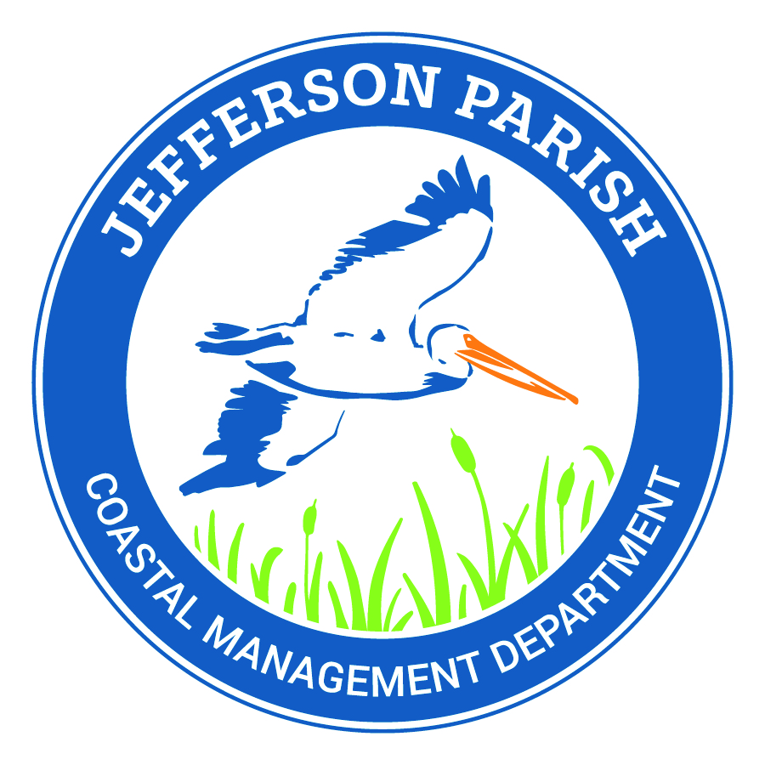
Long-term Coastal Planning A Parish Perspective
Lauren E. Averill, P.E.
Coastal Management Director
Jefferson Parish

Slide 3
Agenda
Jefferson Parish Coastal Overview
Coastal Planning Challenges
Outreach & Education
Funding Streams
Coastal Projects

Slide 4
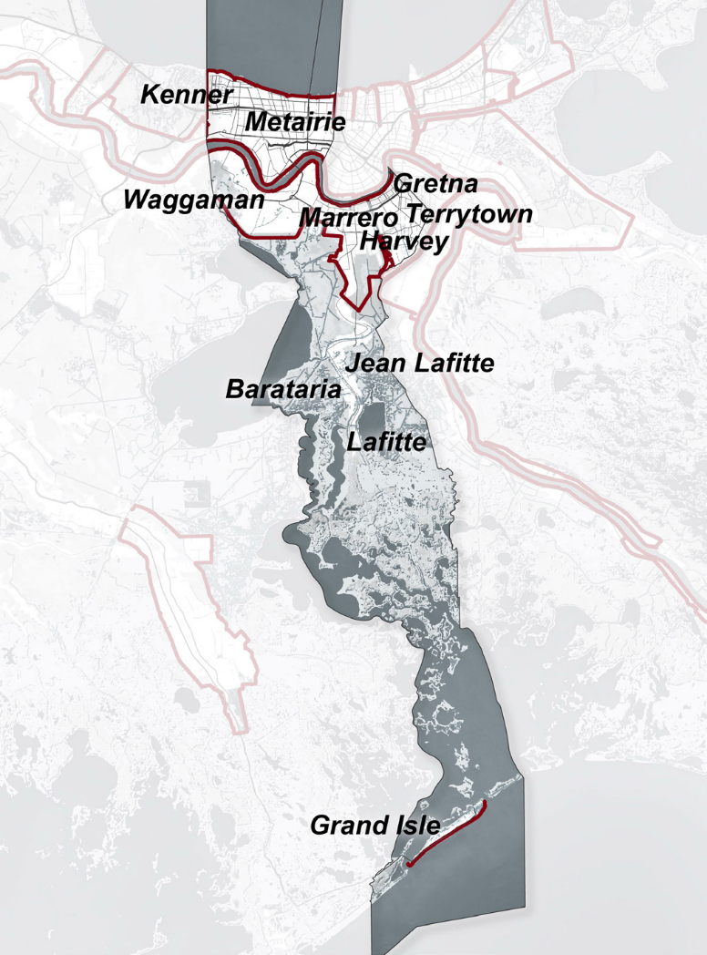
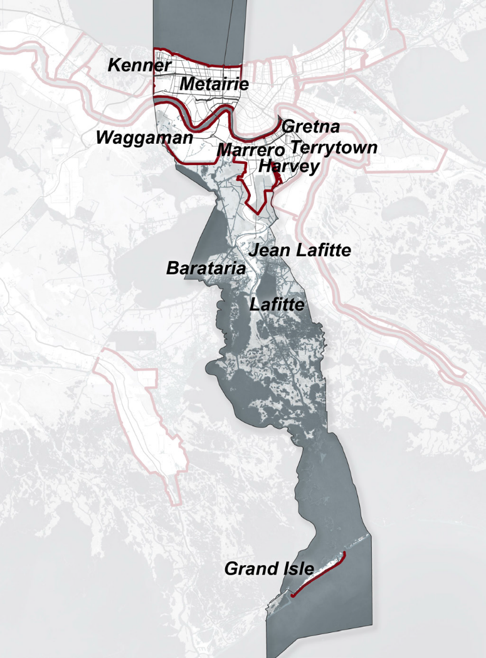
Jefferson Parish Current Land Loss
30% Land Loss over 57 Years
Most populated Coastal Parish in the State with over 433,634 residents
99% Live within the federal levee protection
1960
2017

Slide 5
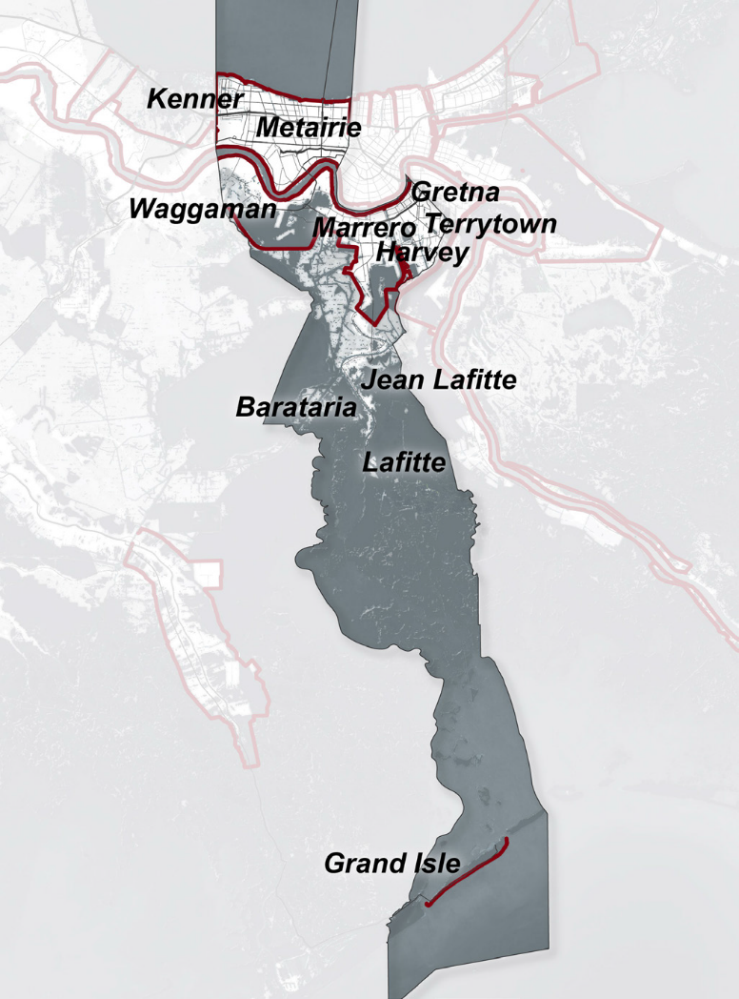
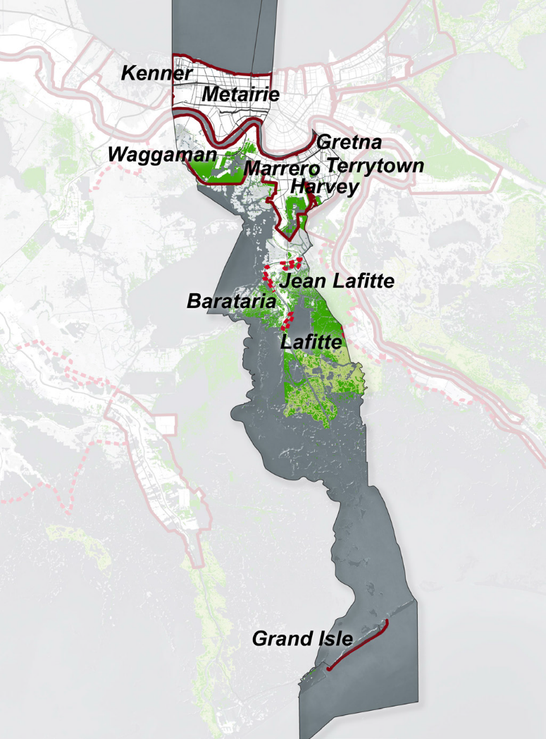
Jefferson Parish Future Landloss
Land loss of 112 square miles or 42% in 50 years
89 square miles maintained or gained with 2017 Coastal Plan
Losing the city of Boston, MA into the ocean
2067
Without Plan
2067
With Plan

Slide 6
Jefferson Parish Overview – Pre-K
1980’s began the states first Coastal Zone Management Program monitoring Coastal Use Permits managed by the state and funded by EPA
1990’s Breaux Act was signed into law creating the Coastal Wetlands Planning Protection and Restoration Act (CWPPRA)
Coastal Restoration Projects handled by the Environmental Affairs Department within the Parish
Jefferson created the first Parish Coastal Comprehensive Master Plan in 1993, revised in 2003, draft revision in 2015 – never adopted
Over 30 years of Coastal Restoration projects in Jefferson Parish consisted of CWPPRA Projects, Corps and State initiatives, and small grants

Slide 7
Jefferson Parish Overview - Post-K
Approximately 30,000 properties were flooded due to pumps
Debris removal for these properties and all associated storm debris was over 5 million cubic yards taking over 3 years
Environmental Affairs Department focus was shifted/allocated to Debris removal, minimal focus on Coastal Restoration
In 2016 under the direction of the new Parish President Mike Yenni, developed the Coastal Management Department within Public Works and hired the first director whose focus is solely on Coastal funding and restoration projects

Slide 8
What are the biggest challenges in Coastal Restoration Planning?
Funding Resources
Politics & Lobbying
Permitting
Real Estate: Mineral and Surface Rights
Public Understanding and Perception

Slide 9
What is the most straightforward phase of building a coastal project?
Engineering & Design

Slide 10
Key to Jefferson’s Coastal Resiliency:
Understand and Utilize Multiple funding streams
Maximum engagement with multiple government agencies
Increasing the public’s understanding to the importance of Coastal Restoration & Land Loss
Issue not just in Jefferson Parish, many coastal parishes (counties) and states along the Pacific & Atlantic oceans, and the Gulf of Mexico
National Academy of Sciences Thriving Communities Grants 5
Topic: Enhancing Coastal Community Resilience and Well-Being in the Gulf of Mexico Region
Jefferson’s Proposal “Strengthening Coastal Resiliency by Translating a Future Without Action to Tangible Consequences Using Interpretive Science”

Slide 11
Increasing Public Knowledge and engagement
Development of Outreach and Education Program
Multi-tiered Stakeholder engagement
Community Leaders
Business Community
Legislators and Politicians
School Teachers and Students
General Public
Upcoming Engagement Events
Oyster Shell Recycling Program – Oyster staging and volunteering headquarters – Looking for a place in Jefferson
Coastal 101 – Public information event held annually
Parish Beach Clean-Ups

Slide 12
Funding Parish Coastal Projects
https://www.youtube.com/watch?v=FCgy0dphOGc

Slide 13
Funding Parish Coastal Projects
https://www.youtube.com/watch?v=FCgy0dphOGc
Jefferson’s Current Funding Streams
State & Federal Project Funding
Out of the Box
Leveraging Funds

Slide 14
Jefferson’s Coastal Funds
GOMESA – Gulf of Mexico Energy and Security Act – By law must be spent on Coastal Restoration and/or Hurricane Protection
Phase 1 : 2006-2016 - $200K
Phase 2 : 2017: $1.3M - Only 40% Max Cap of $3.2M
BP Economic Settlement – Not tied to Coastal projects $35M among 5 districts within the Parish
RESTORE Parish Allocation – Dept of Treasury - $14.3M over 15 Years
Future Coastal Mileage

Slide 15
State and Federal Funding –
CPRA - 2017 State Master Plan –
Beach Restorations
Large Scale Marsh Creation
Mid-Barataria Sediment Diversion
Corps of Engineers
BUDMAT Program –Beneficial Use of Dredged MATerial
Planning Assistance for the States (PAS)
WRDA – Water Resources Development Act
CWPPRA
Approximately $85 to the program of 5
5 Federal Agencies Participate in the Annual Project Selection Process
CIAP - Coastal Impact Assistance Program (CIAP)
Federal grant funds derived from federal offshore lease revenues
Recipients - Oil producing states for conservation, protection, or restoration of coastal areas

Slide 16
How can a parish leverage their funding?
Bonding
Green (Environmental Bonds)
Outcome Based Performance Contracting (Large Projects)
P3 – Public – Private – Partnership
Granting Cost Shares

Slide 17
Projects & Partners
LDSP – Long Distance Sediment Pipeline
Caminada Headlands Beach Restoration
Lafitte Shoreline Protection
BUDMAT – Barataria Waterway
Bucktown Wetland Boardwalk & Harbor
Christmas Tree Recycling Project for Shoreline Protection

Slide 18
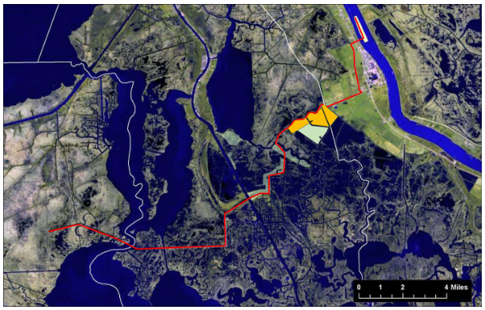
Mississippi River LDSP – Long Distance Sediment Pipeline
Construction Completed 2016
Built 1,039 acres for $123.2 Million
$119,000 per Acre

Slide 19
Mississippi River LDSP – Long Distance Sediment Pipeline – Phase 1
Project | Funding Source | Cost (Millions) | Volume of Fill (Cubic Yards) | Acres
Bayou Dupont Marsh and Ridge Restoration (BA-48) | CWPPRA | $38.2 | 2,710,422 | 360
Bayou Dupont Sediment Delivery Marsh Creation #3 (BA-164) | CWPPRA | $18.7 | 1,107,855 | 124
Long Distance Sediment Pipeline (BA-43EB) | CIAP/State Surplus/Mitigation Funds | $66.3 | 4,330,524 | 1,039
TOTAL |  | $123.2M | 8,148,801 | 1,039

Slide 20
Mississippi River LDSP – Balancing Water

Slide 21
Phase 2 – Mississippi River Long Distance Sediment Pipeline

Slide 22
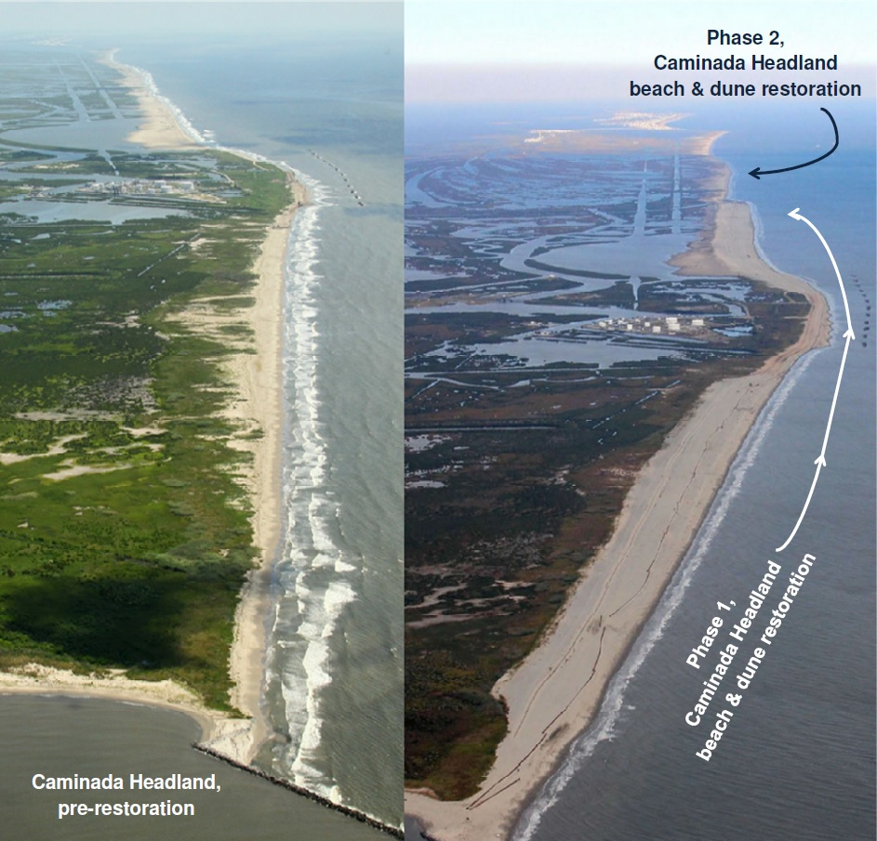
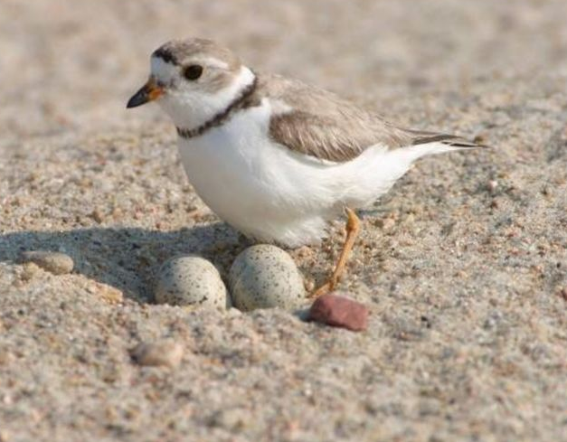
Caminada Headlands Beach Restoration
Completed December 2016
Total Project Cost: $216 million
Funding Partners: CPRA, NRDA – BP Damages Assessment Penalties
1,000 acres of wildlife habitat
13 miles of beach from Port Fourchon to Elmer’s Island
Volume of Sand: 9 million cubic yards, or 1,047 football fields, of offshore sand from Ship Shoal
Additional projects to restore the marsh behind the island have also been completed, and are in design

Slide 23
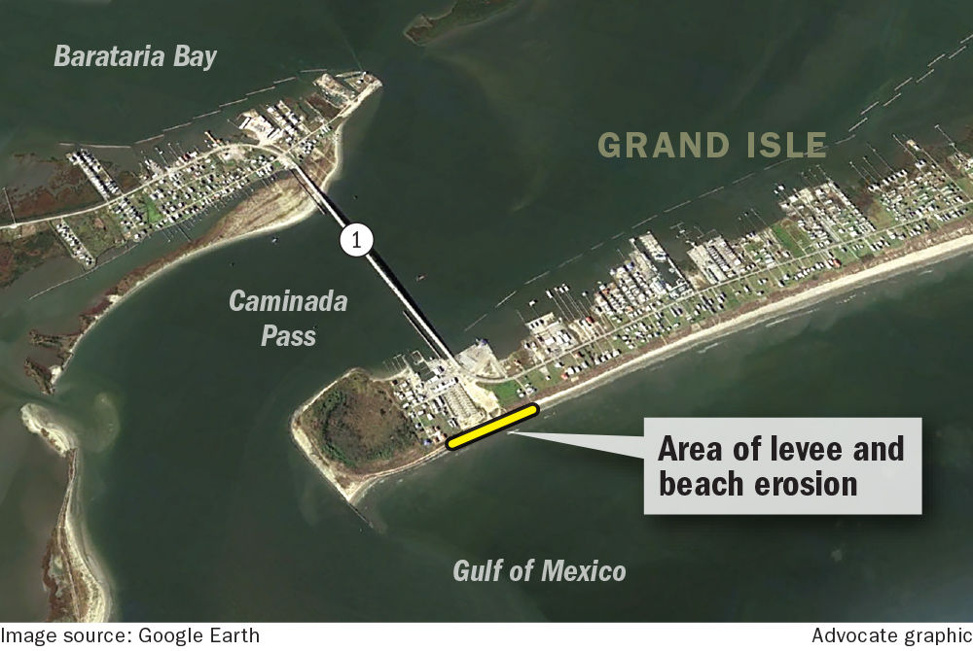
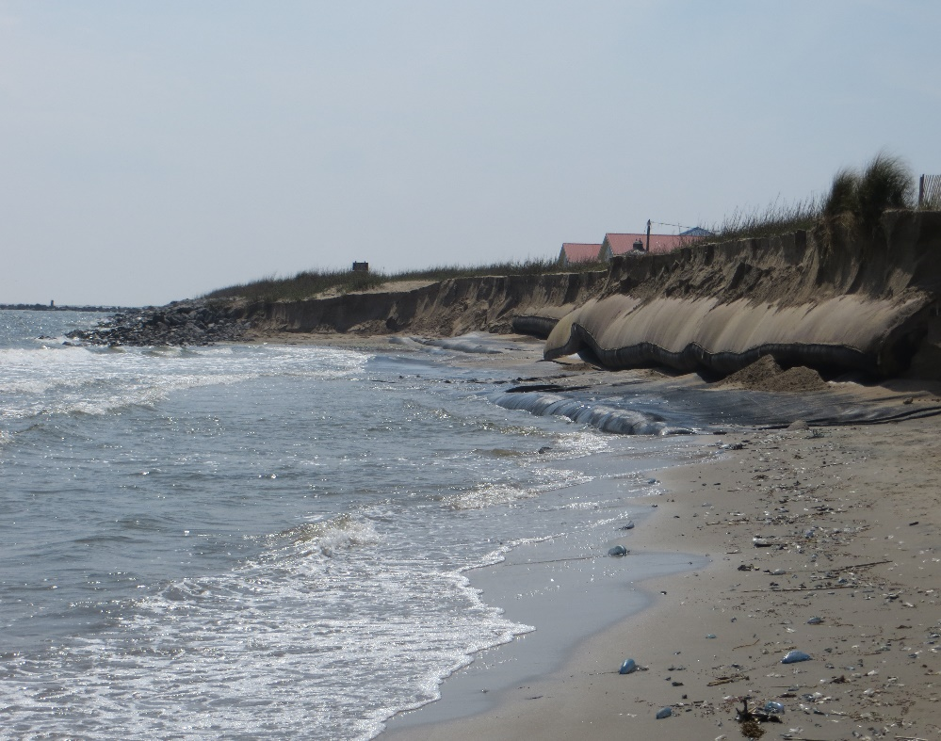
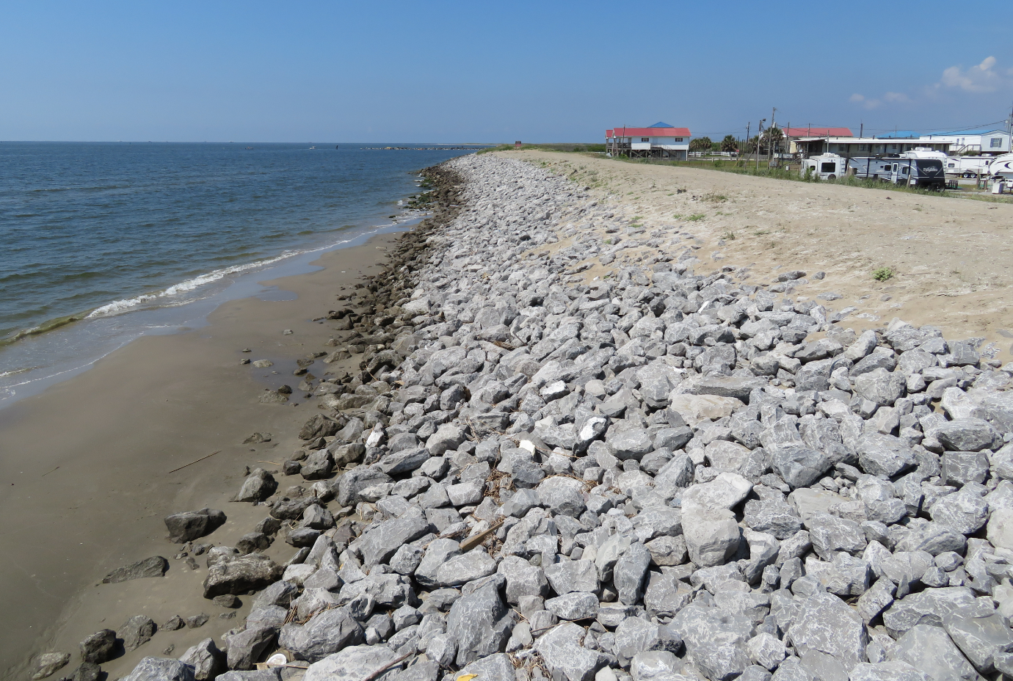
Grand Isle Emergency Dune Repair-2017
Cost: $2.8M
$1.5M – JP District 1 BP Economic Settlement Funds
$1.3M – State & Federal storm damage
Study and Redesign of Beach Hotspot - $15M
Funded by CPRA
Initial hydrologic studies completed

Slide 24
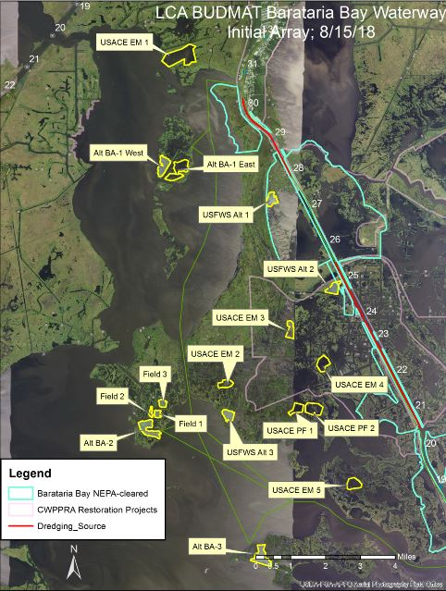
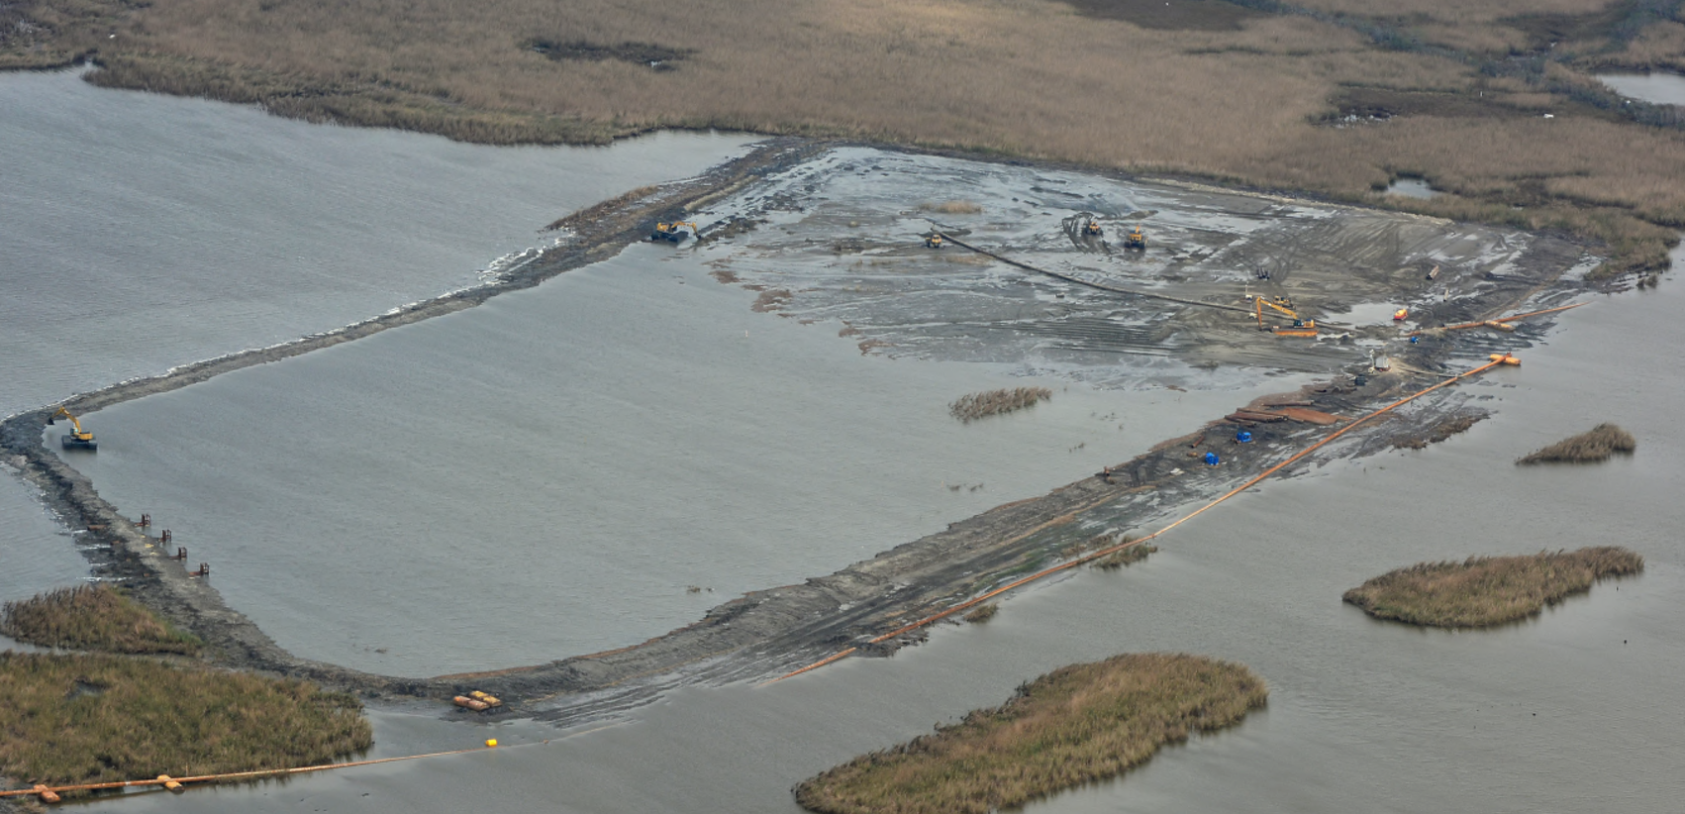
BUDMAT - Barataria Waterway Project
Corps of Engineers program to use material dredged for navigation of federal waterways
75/25 Cost Share
Design: $1.5
NFS(JP): $367K
Volume: 500 cy
Build approximately 60 acres
Notes:
Beneficially Using material from the Corps dredging the Federally Navigable Barataria Waterway
75/25 Cost Share between the Corps Jefferson Parish
$1.47M Design Cost
Slated for Dredging Cycle Fall 2019

Slide 25
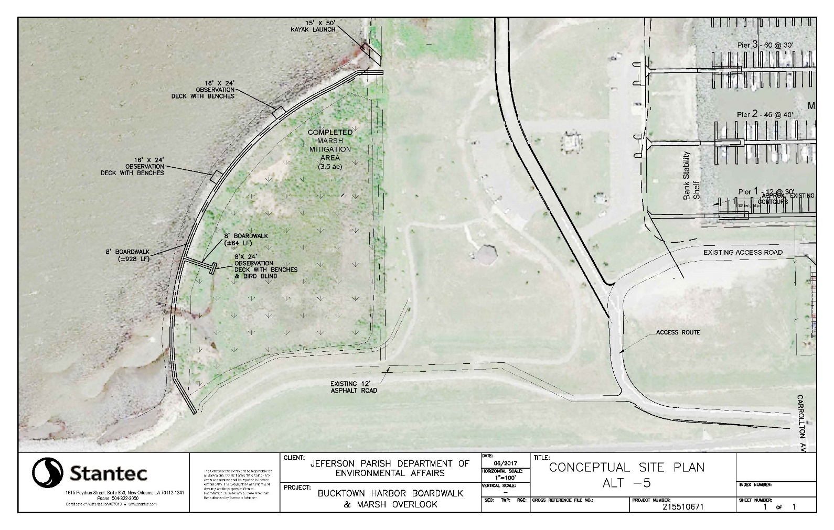
Bucktown Wetland Boardwalk
Cost - $130,000
Preliminary Design/Permitting - $25,000
Final Design - $105,000
75/25 Cost Share with the Lake Pontchartrain Basin Foundation (UNO/EPA)
Parish Costs: $32,500
Possible Construction Funding
CDBG
State Capitol Outlay

Slide 26
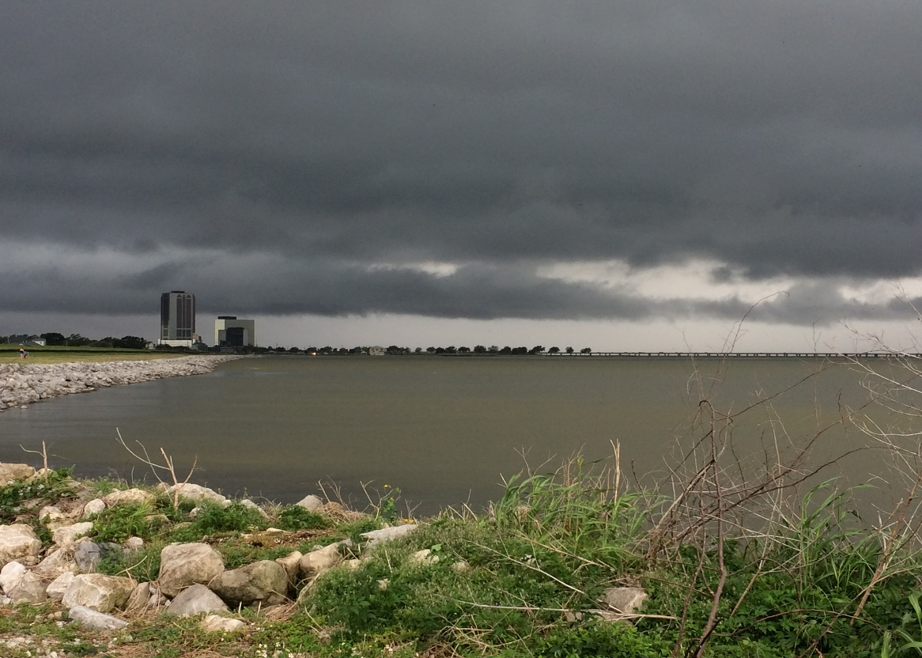
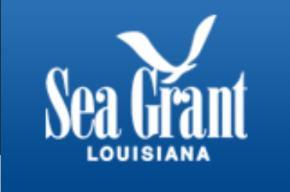
Bucktown Wetland Restoration Project

Slide 27
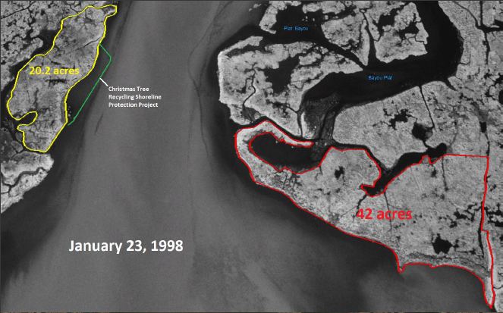
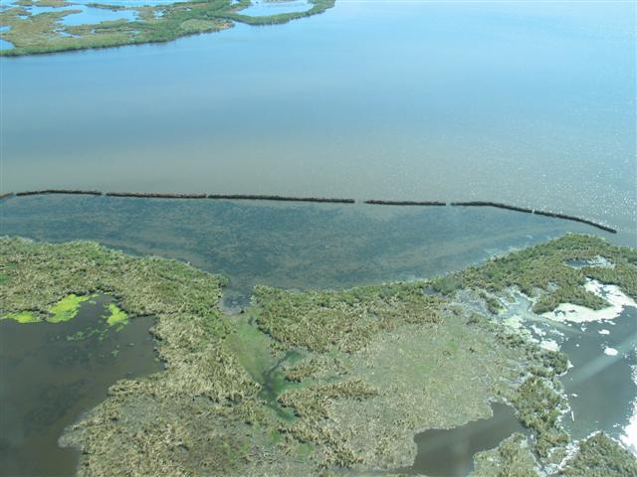
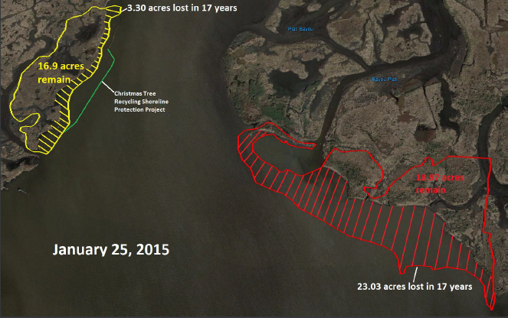
Christmas Tree Recycling Project
In 29 years Jefferson has recycled approximately 800,000 trees, distance of 900 miles tip to trunk
https://www.nbcnews.com/nightly-news/video/christmas-trees-come-to-the-rescue-in-coastal-louisiana-1147610179678?v=railb&

Slide 28
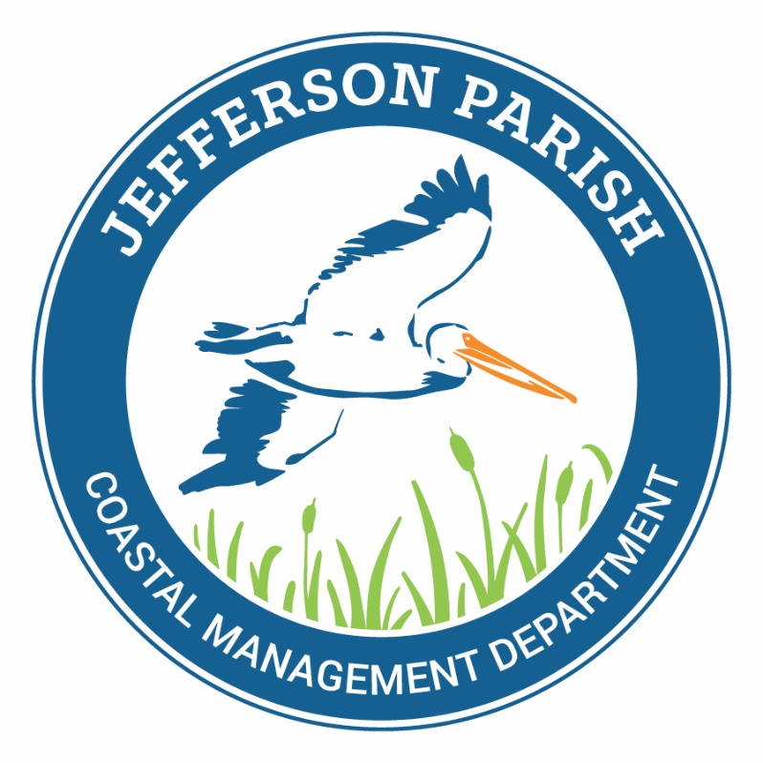
Questions & Answers?
Lauren E. Averill, P.E.
(504) 736-6653
laverill@jeffparish.net

